Slide 1
Vehicular Ad-Hoc Networks
(VANET)

Slide 2
Overview
VANET is special kind of MANET.
Vehicle systems are connected with the networks.
VANET initially used by,
Police vehicles.
Fire Engines.
Ambulances.
In this network's vehicles can communicate with other vehicles within 100 to 300 meters.
Multi-hop networks.
In the city or highways networks size may be an kilometers wide.

Slide 3
Important uses of VANET
Drivers can get advanced warnings and information from nearby environment via message exchanges.
Road accidents may trigger chain of events in highways. It helps to apply emergency brake system to avoid further collision.
It give the geographical information to the drivers. For example food malls, petrol filling stations, map display, etc.
Driver can communicate with mobile networks and enjoy the services like VoIP, news highlights, Video conferencing and entertainment.

Slide 4
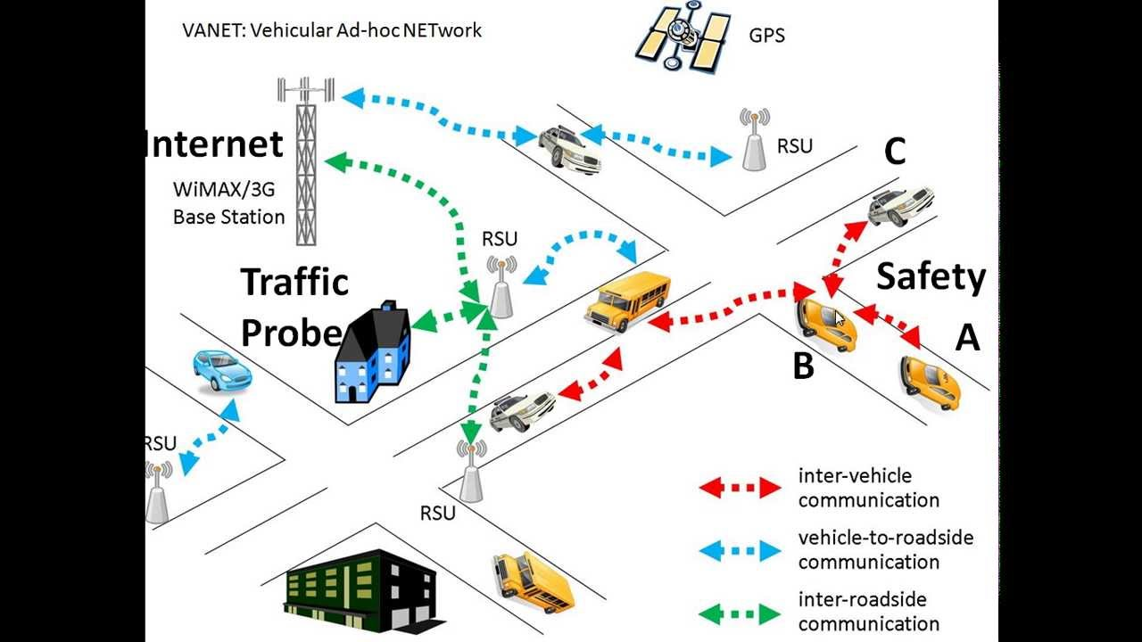
Communication in VANET

Slide 5
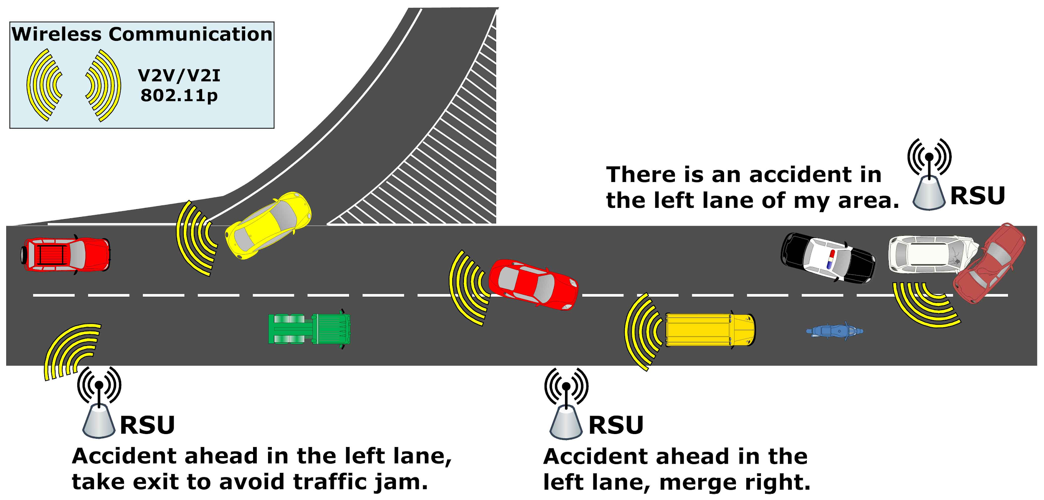
VANET and Road Accidents

Slide 6
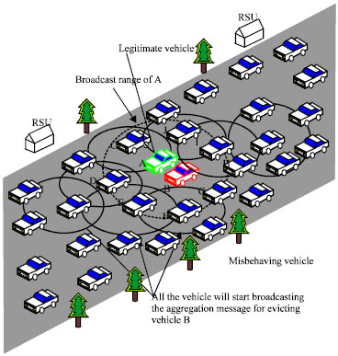
Crowdsourcing in VANET

Slide 7
MANET and VANET
MANET | VANET
Collection of mobile node that communicate with each other without having any infrastructure | It is special kind of MANET. Nodes on the move and can establish an ad-hoc with other vehicle and as well stand alone roadside units (RSU) for communication.
Movement of nodes in MANET is more random. | Node mobility is constrained to the road topologies.
We can’t expect fastest topological changes in MANET. | VANET goes fastest topological changes because of speed of vehicle.
Power is major constraint in MANET | Vehicle can power VANET more effectively.
Moving speed does not consider for MANET design. | Moving speed of the node has design effect on VANET

